Slide 1




NEXT GEN EMPLOYABILITY PROGRAM
Creating a future-ready workforce
Team Members
College Name
Student Name : SUNDARALINGAM B
Student ID :au110321104304
NM ID : au110321104304
Email : slingam372@gmail.com
1103 - GRT Institute of Engineering and Technology,Tiruttani

Slide 2
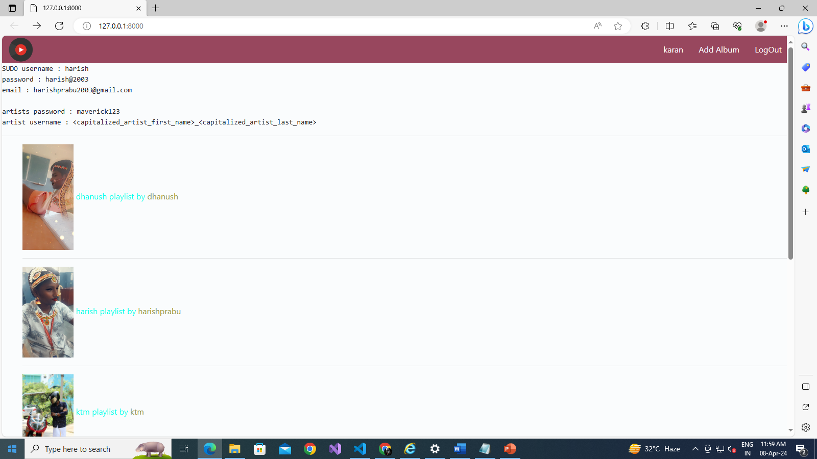

Slide 3
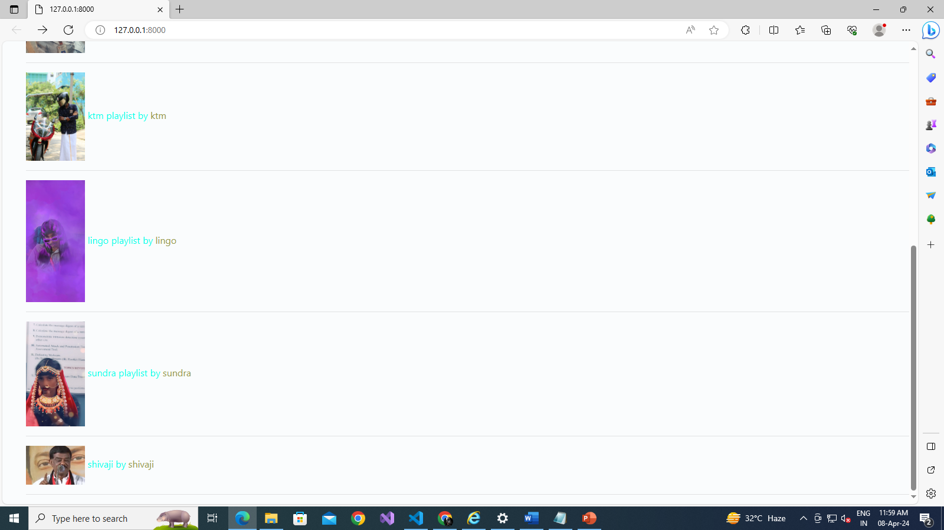

Slide 4
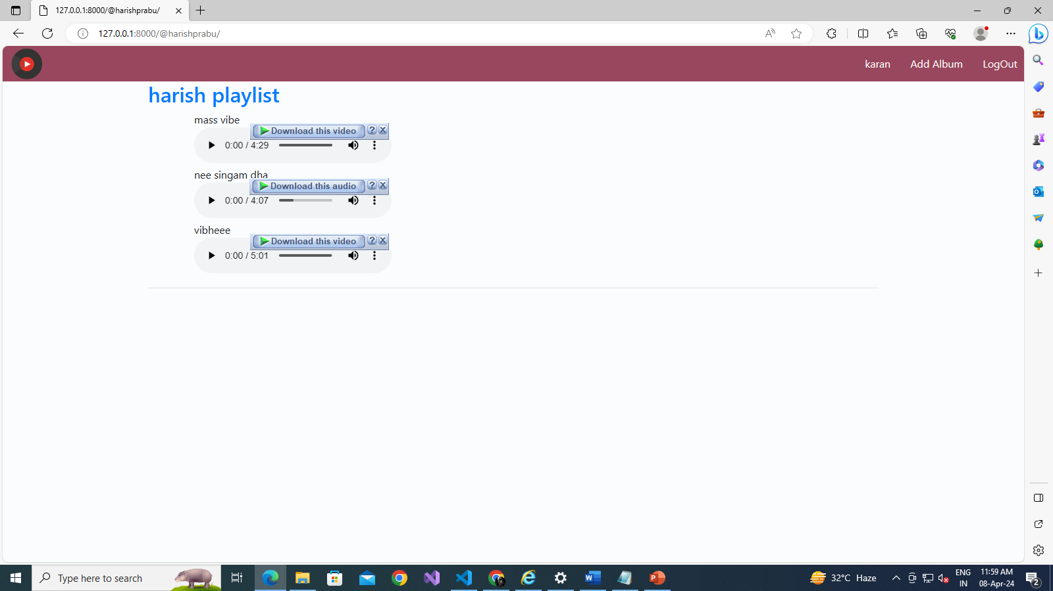

Slide 5
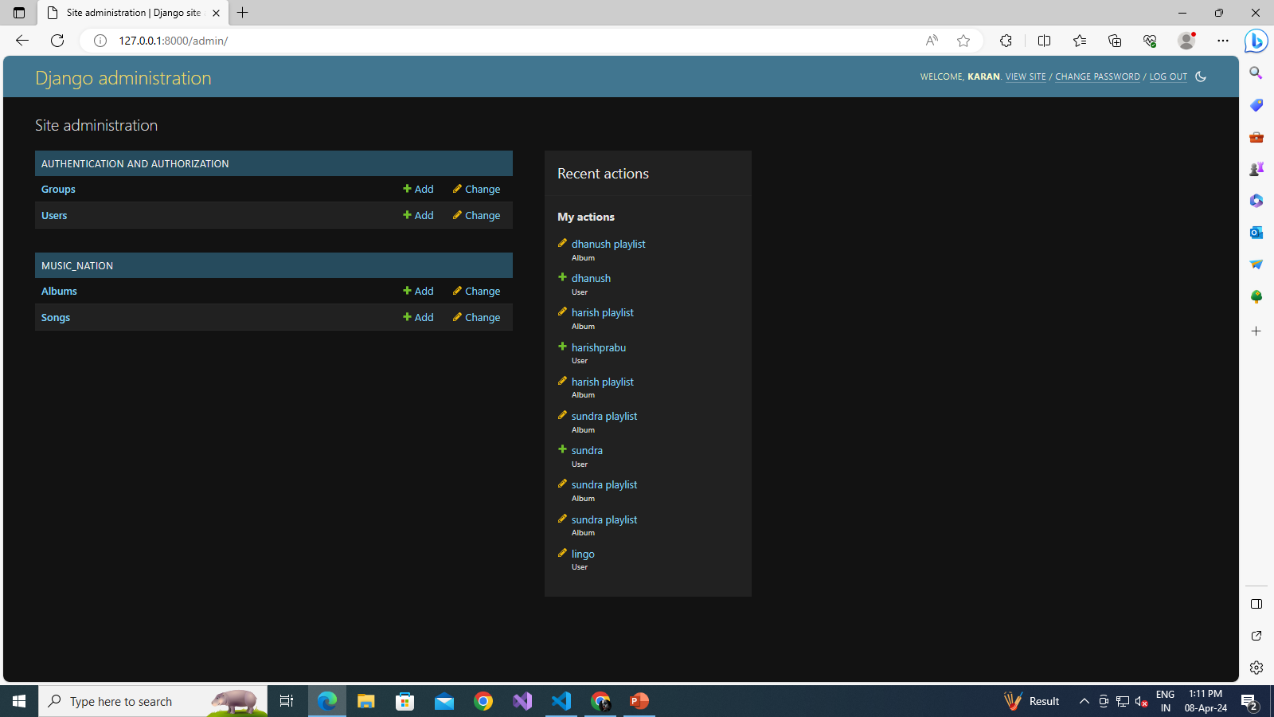

Slide 6


Slide 7
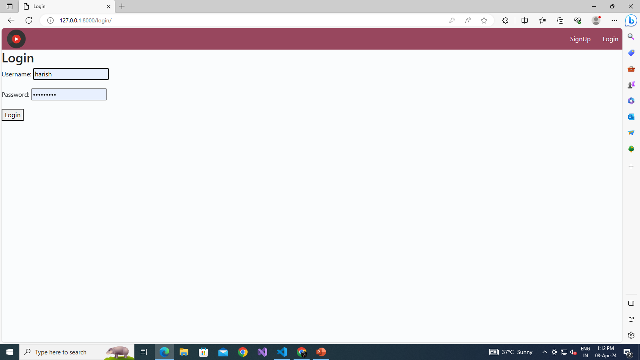

Slide 8
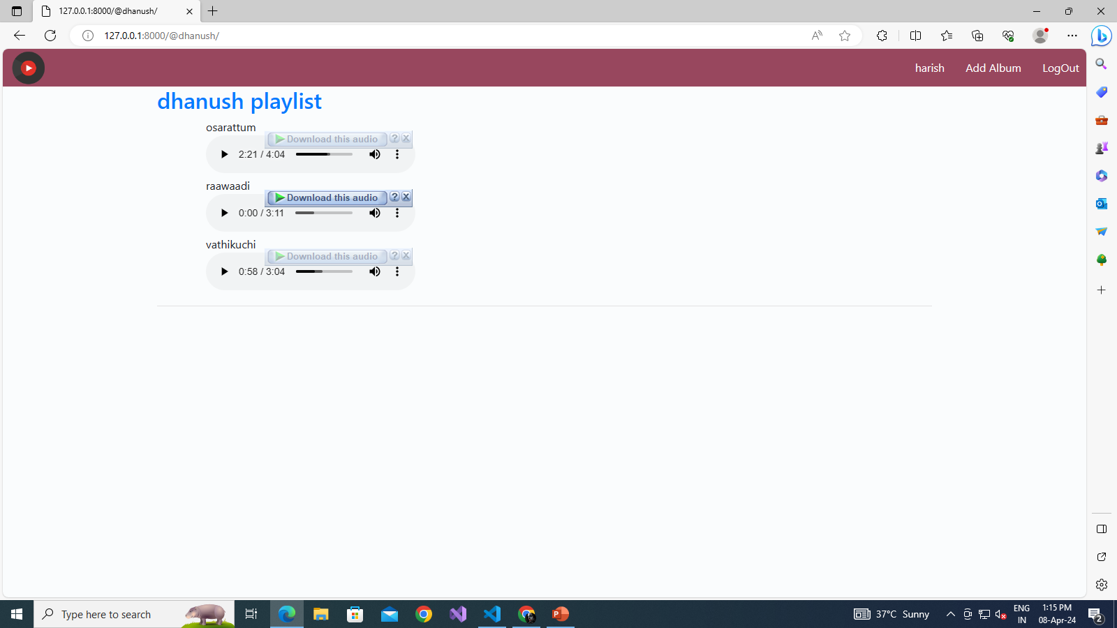

Slide 9
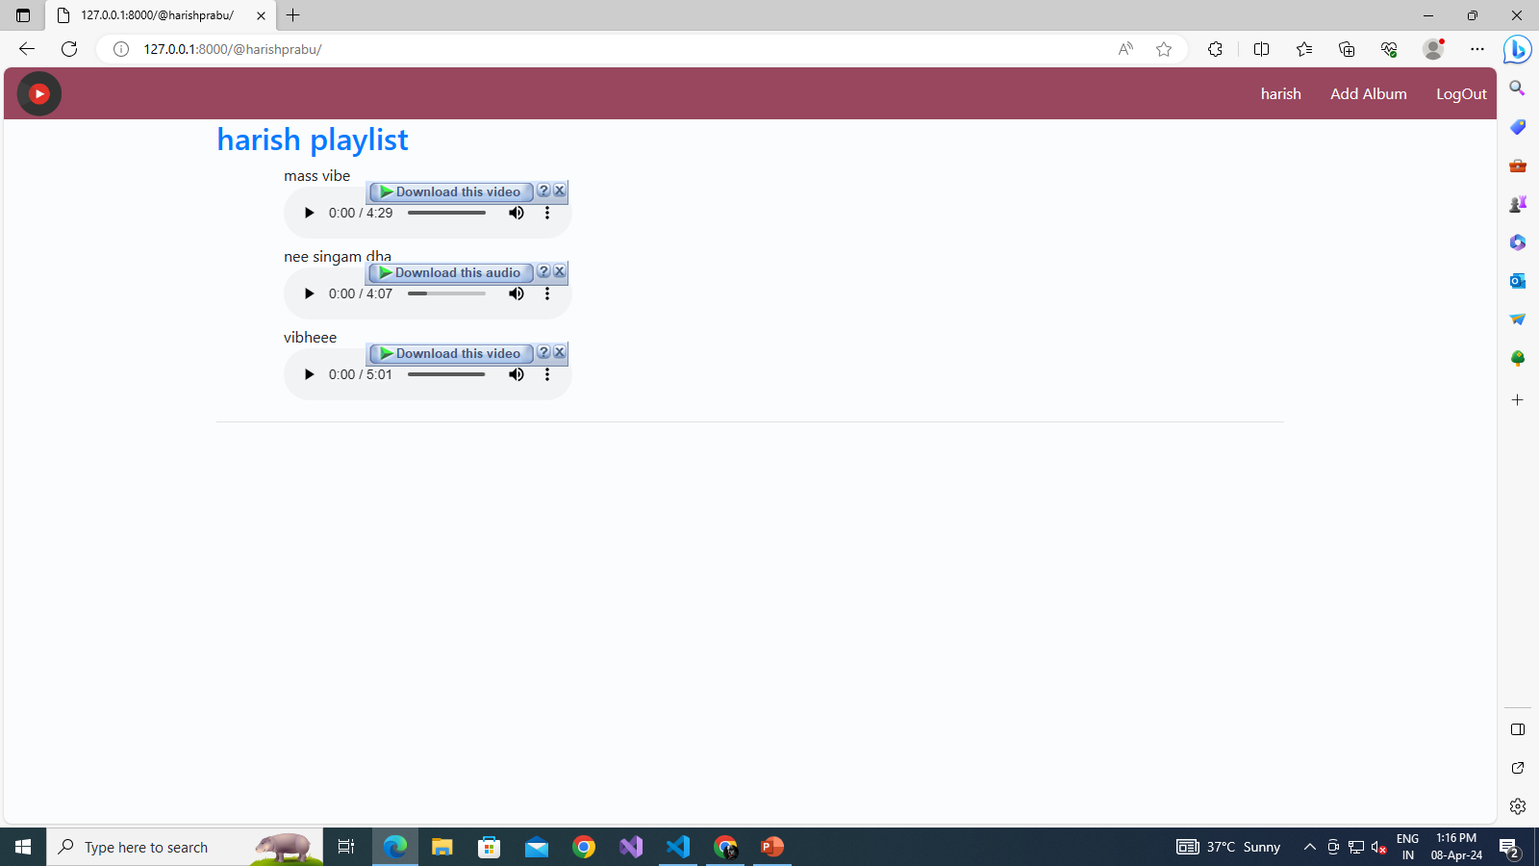

Slide 11
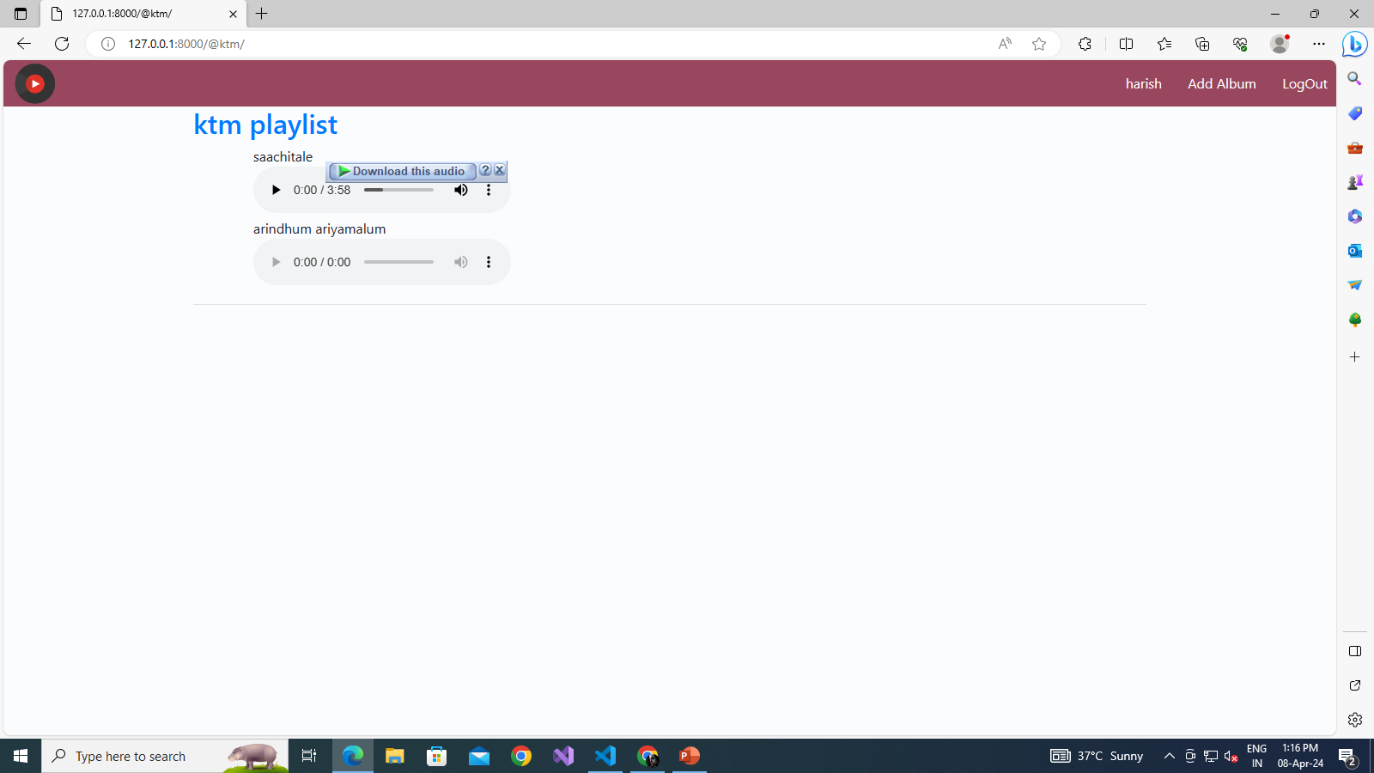

Slide 12
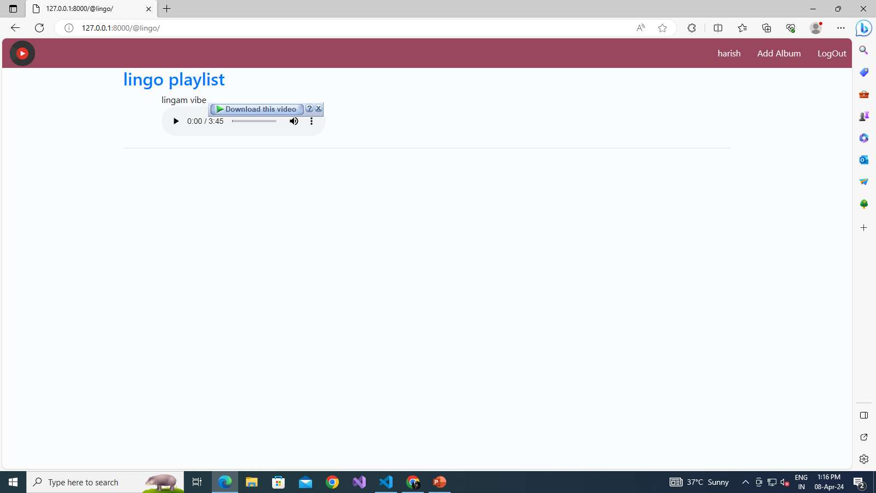

Slide 13
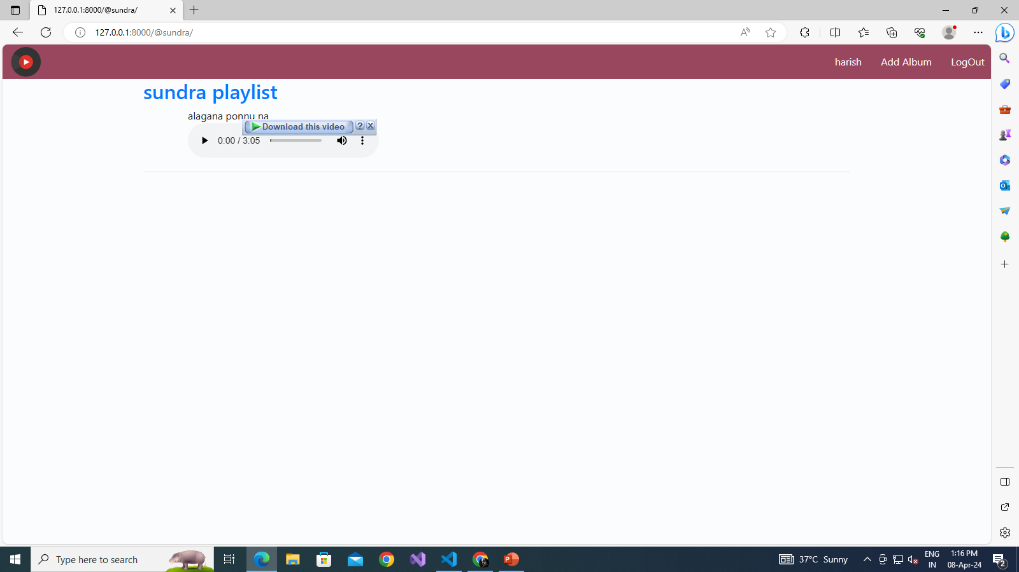

Slide 14


Slide 15
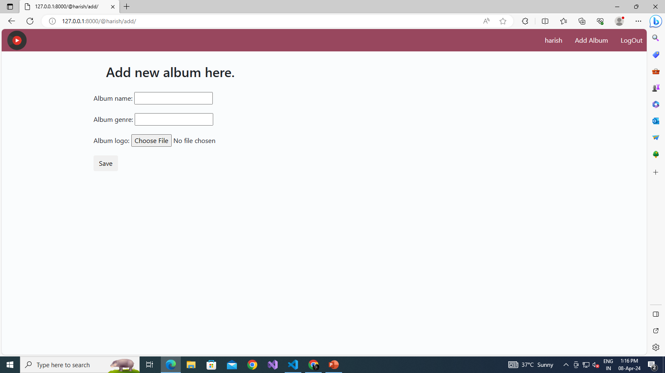

Slide 16
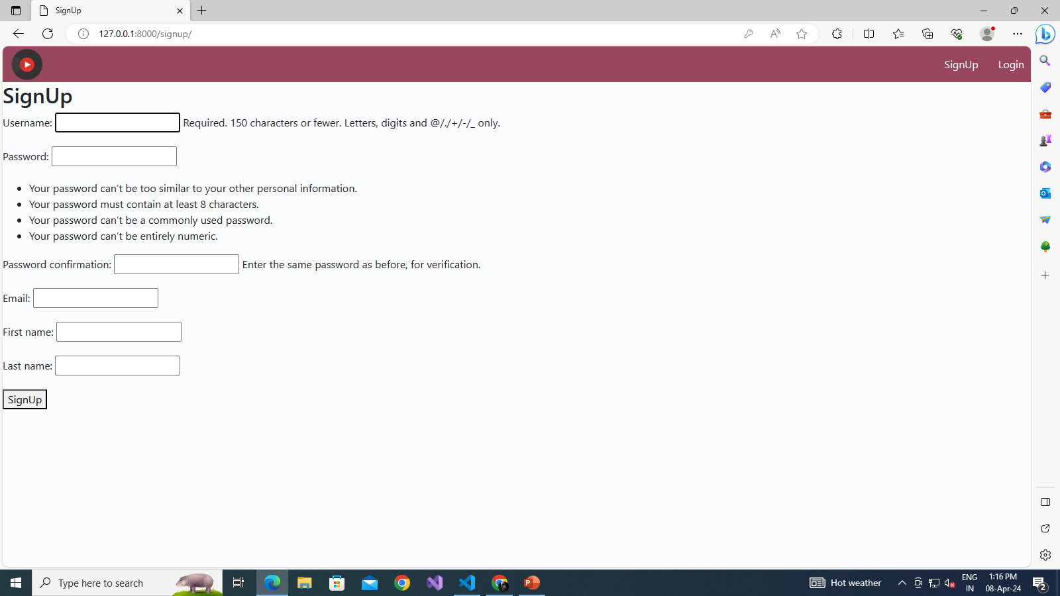

Slide 17
